Slide 1
人工智能导论 非专业自制版 A introduction of AI non-professional homemade version
For my daughter

Slide 2
Preface 前言
Purpose 目的
To tell my lovely daughter who studies in a junior school, what is A.I., what AI capable of and what AI not capable of.
让我可爱的小学四年级闺女知道人工智能是啥玩意儿，它能干啥，它不能干啥
Why 为什么
A plenty of incorrect and abuse news of A.I. full of media, which gives misunderstandings to public
现在的新闻、自媒体、翻译和编辑啊，太不负责任了，关于人工智能各种不正确的信息和技术滥用的消息充斥满屏满眼，给公众带来了太多误解
I believe that A.I. should realize the potential of whole human society, accelerate the developing progress of life wealthy, economy, science and so on.
AI 的研究和应用可能会释放整个人类社会的潜力，加速社会财富、国民经济和科学研究等的进步
Required knowledge 开始前需要知道的基础知识
Introduction of computer for junior school 小学生的计算机导论(计算机科学基础知识概念)
Fundamental mathematics小学数学(加减乘除，对方程函数的概念认知，不要求掌握方程函数)
Fundamental programming like scratch and junior python基础编程入门知识，例如scratch 和python
Other common sense which a junior student should have小学生应有的其他常识
BTW: bilingual slides for practice technology and English in the same time, if there are any error, please feel free to let me know.
顺便说一下啊，使用中英双语片子是为了同时教育孩子技术与练习英语，本人比较菜，如有错误，请告知。

Slide 3
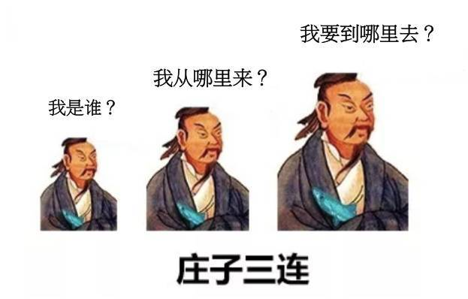
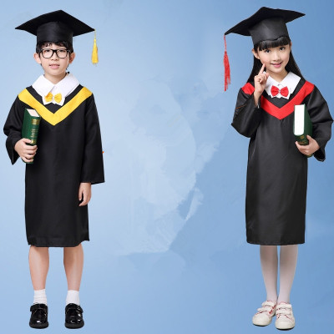
Three ultimate philosophy questions to describe Artificial Intelligence 描述人工智能的三个终极哲学问题
Who am I?我是谁
What is A.I.
人工智能究竟是什么？
Where am I from?我从哪里来
Who invented A.I.? And how it grown up?
人工智能如何诞生和发展的？
Where should I go?我要到哪里去
What is the ultimate goal of A.I.?
人工智能发展的终极目标是什么？

Slide 4
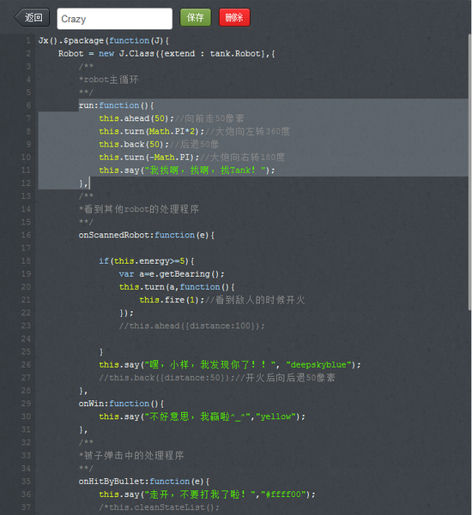
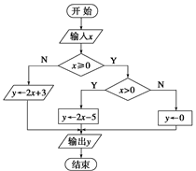
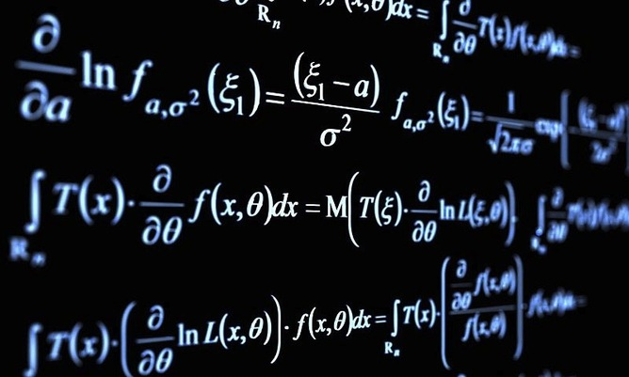
What is Artificial Intelligence?(1) 人工智能究竟是什么
AI (Artificial Intelligence) is a sort of computer program which can do something like human.
人工智能是像人类一样做某些事的一种计算机程序
It consist of control flows and mathematic equations
与其它软件一样，由控制流程与数学公式组成

Slide 5
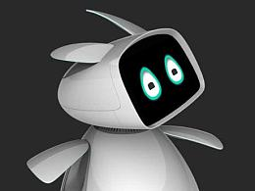

What is Artificial Intelligence?(2) 人工智能究竟是什么
AI agent
Two form of AI 人工智能的两种体现形式
AI agent
机器人等，由人工智能直接控制的设备，AI能直接影响物理世界
AI tool
Siri，小冰等，人工智能仅协助人类完成信息处理，AI无法直接影响物理世界
AI tool

Slide 6
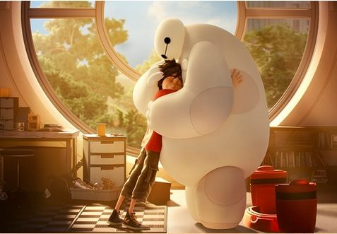
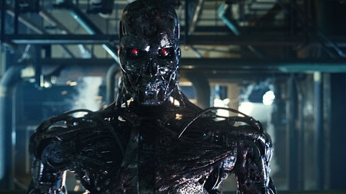
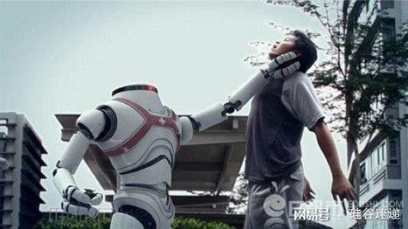
What is Artificial Intelligence?(3) 人工智能是什么？
Is it good? Or Bad?
人工智能是好的？还是坏的？
It is just a software program, NOT GOOD, NOT BAD. It’s up to the its creator.
它只是一个软件程序，不好也不坏，究竟咋样取决于创造它的人类。
If it learns from environment after born, it may will become something like a mean value of all humans.
如果人工智能被设计为出生后从周围环境中学习，它的行为会像一个三观为全体人类的综合体的东西。

Slide 7
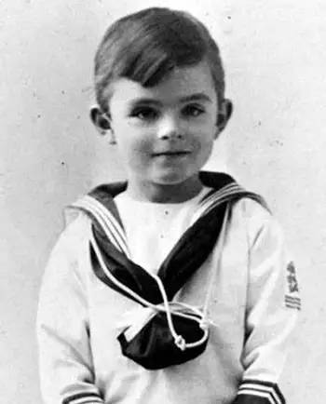
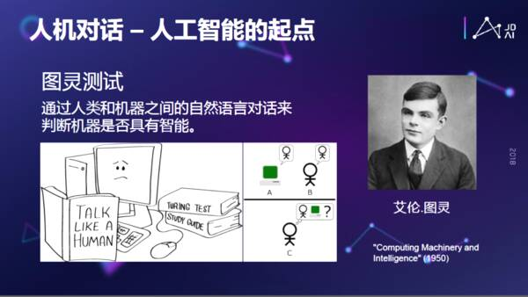
History of AI 人工智能的发展历程
The idea of A.I. born in the same time of computer’s
Alan Turning and Turning Test

Slide 8
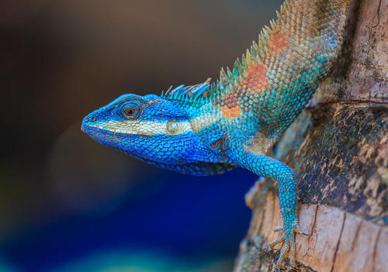
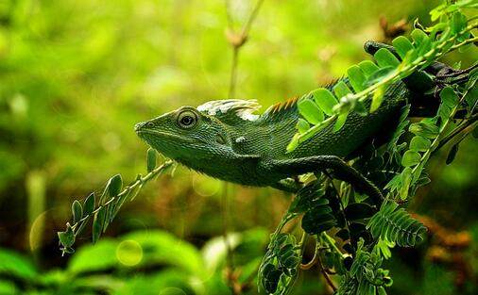
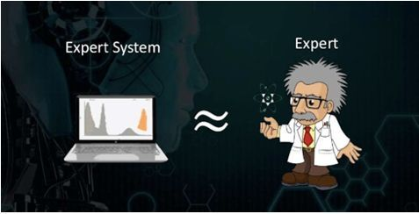
History of AI 人工智能的发展历程
Pattern recognize 模式识别
‘Pattern’ is something same among different things
人们在观察事物或现象的时候，常常要寻找它与其他事物或现象的不同之处，并根据一定的目的把各个相似的但又不完全相同的事物或现象组成一类。
For instance, OCR( Optical character recognition) is a kind of Pattern Recognize.
例如，手写体识别（光学字符识别）就是一种模式识别。
Expert system 专家系统
Expert system stores a lots of rules which from human expert.
It can act like a real human expert.
专家系统是将人类专家给出的业务规则进行存储并运用的系统
专家系统能像人类专家一样做一些工作

Slide 9
Different paths of A.I. developing AI技术发展的几个典型流派
Symbolism 符号主义
Representing the real world concepts with mathematic symbol, applying some algorithm to simulate human intelligence.
用数字符号来代表真实世界中的各种事物概念，并用逻辑推理算法模拟人类的智能
Connectionism 连接主义
Simulate the neural network in human brain with computer algorithms, the algorithm can learn from data and do some particulate job like human.
用计算机算法模拟人类大脑中的神经网络，能从数据中学习客观规律并像人类一样做某些特定的任务
Actionism 行为主义
Simulate the animal’s conditional reflex instinct with algorithms, and use some specificity scenario data to train it to do some particular job like human.
用算法来模拟动物的条件反射本能，并用某些特定场景数据来训练人工智能像人类一样去做某些特定的任务。

Slide 10
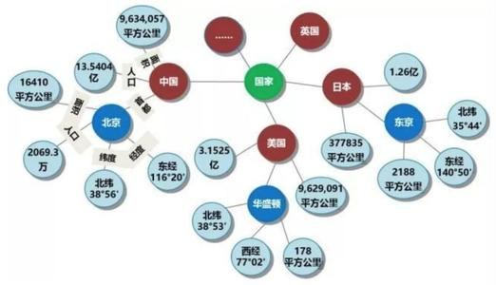
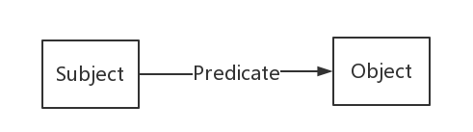
Symbolism 符号主义
Basically, Symbolism is trying to represent all the necessary information with number, and trying to use some algorithm to simulate human reasoning mechanism.
本质上来说，符号主义试图用数字符号来表示所有需要的信息，并且用算法来模拟人类的推理机制。
Typical symbolism technology: Semantic-web, RDF, Knowledge Graph
代表性技术: 语义网、RDF、知识图谱等

Slide 11
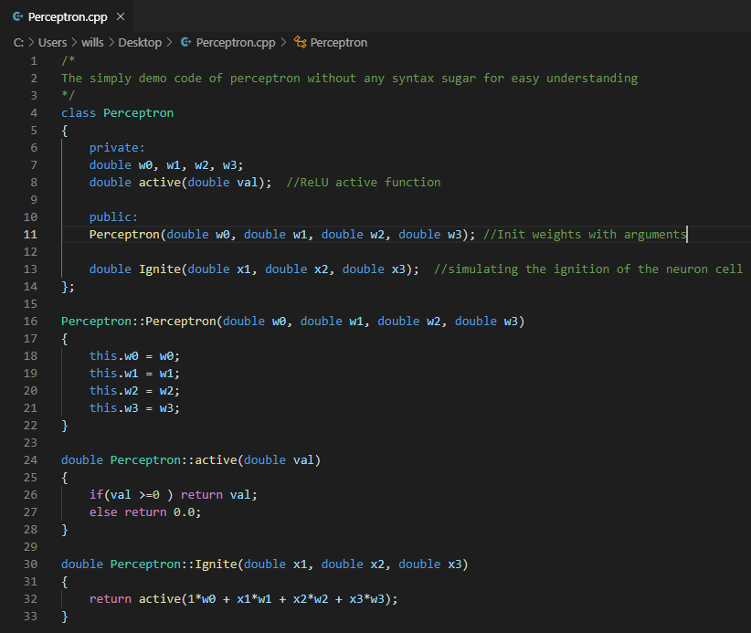
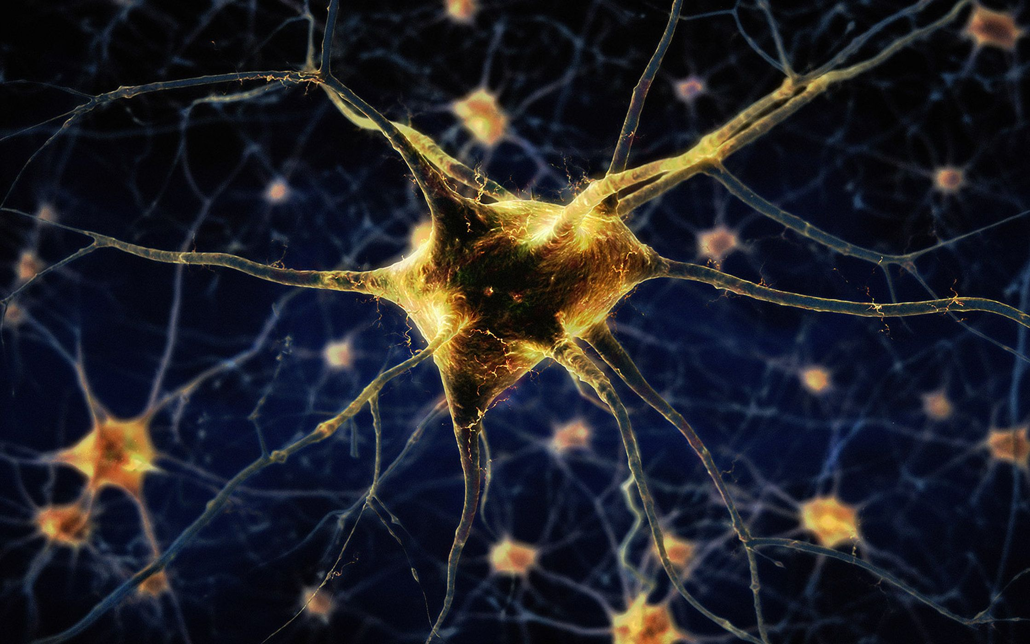
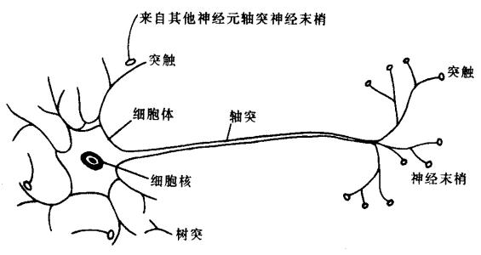
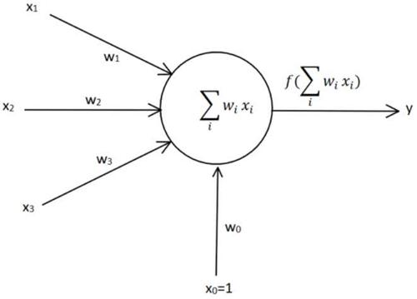
Connectionism 连接主义
Roughly, connectionism is trying to simulate human brain neural system with computer algorithm.
简单说，连接主义就是试图用计算机算法来模拟大脑中的神经系统。
Typical connectionism technology: deep learning, neural network
代表性技术: 深度学习、神经网络
医学领域
计算机领域

Slide 12
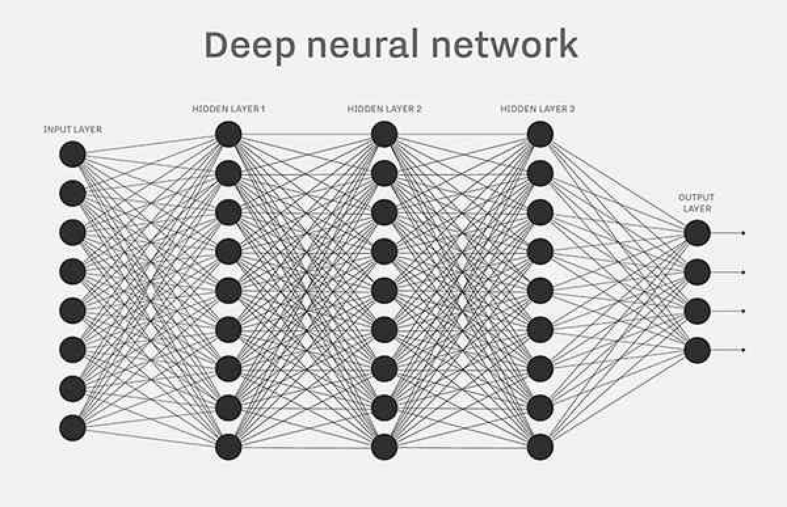
Connectionism 连接主义
For connectionism, a SOTA(state of the art) technology is deep artificial neural network.
连接主义中，一个很火的先进技术是深度人工神经网络。
Which is consist of lots of artificial perceptron.
它由非常多的人工神经元组成。
We call it deep, when it consist of great many layers
当人工神经网络由非常非常多的神经元网络层组成时，我们将之称为深度神经网络
Each dot is a perceptron
每个黑点是一个人工神经元
This is a perceptron layer
这是一个神经元网络层
Y=active(w0+w1*x1+
w2*x2+w3*x3)
Each perceptron equals to a simple function
每个工神经元相当于一个函数

Slide 13

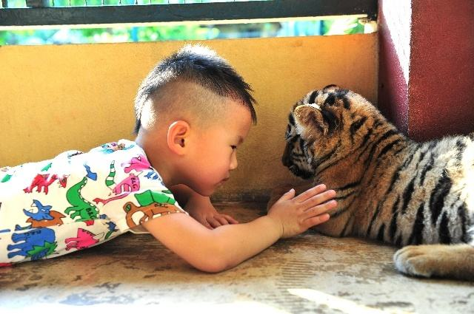
Actionism 行为主义
Roughly, actionism is trying to train a software to do some particular task, just like training a pet to do some tricks.
简要的说，行为主义是尝试训练软件去做某个特定任务，就像训练宠物做某个特定的任务
During the training period, the A.I. gains a positive reward when it doing right, and gains a negative reward when it doing wrong.
在训练期间，人工智能做对时会得到一个奖励，做错时会受到惩罚
Typical actionism technology: reinforcement learning
典型行为主义AI技术：增强学习

Slide 14
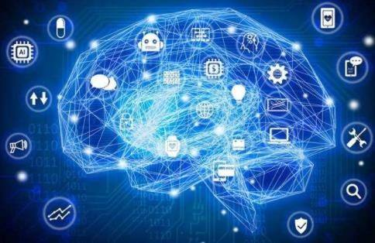
What is the ultimate goal of A.I. 人工智能技术的终极目标是什么
In my opinion, A.G.I. (stands for Artificial General Intelligence) is the ultimate goal of A.I. technology.
通用人工智能是A.I.技术发展的终极目标
A.G.I. is a kind of A.I. that capable of doing multiple tasks like human.
通用人工智能是像人类一样能完成多种任务的AI
The S.O.T.A A.I. is only capable of doing one specific task for now.
现在最先进的人工智能仍然只能完成某一项特定的任务。
The holy grail of A.I. technology is concept abilities
人工智能技术的“圣杯”是给予A.I.理解概念的能力

Slide 15
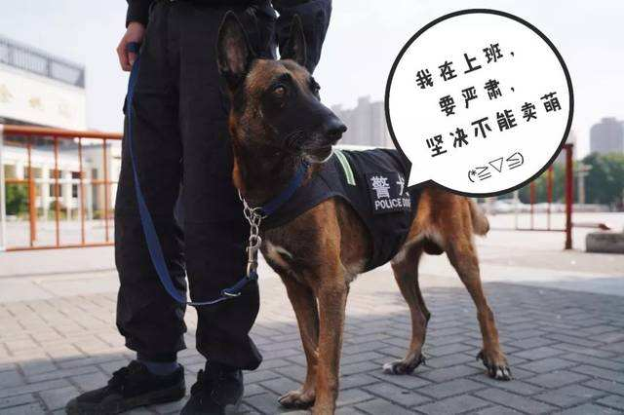
A suggestion for the right understanding of A.I. for nowadays 当前技术条件下,对人工智能正确认知的一个建议
It’s just like a very smart pet of you
像一个非常聪明的宠物
It was trained to do something better that human
它被训练成在做某些事时比人类做的更好
i.e. explosive detection dogs have more sensitive nose than humans, and its had been trained particularly.
例如，搜爆犬有比人类更灵敏的嗅觉，接受过更专业的搜爆训练

Slide 16
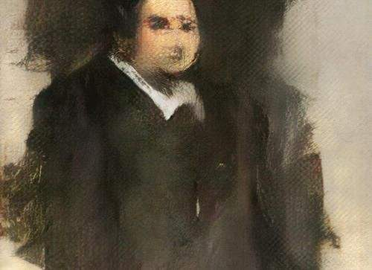
What is AI capable of and not capable of? AI能做到什么？做不到什么？
AI is capable of
Singing simulation
模仿唱歌
Painting simulation
模仿作画
Chatting simulation
模仿聊天
And lots of tasks
还有很多很多很多。。。
人工智能自主作的画
第六代微软小冰唱歌

Slide 17

What AI capable of and not capable of? AI能做到什么？做不到什么？
AI is NOT capable of
人工智能做不到什么
Feeling the joy, pain, happiness, angry, sad
感觉到愉快、痛苦、喜怒哀乐
Loving something or someone
爱
Having empathy with humans
同理心
Having self awareness, for exactly the psychology definition.
有心理学上严格定义的自我意识

Slide 18
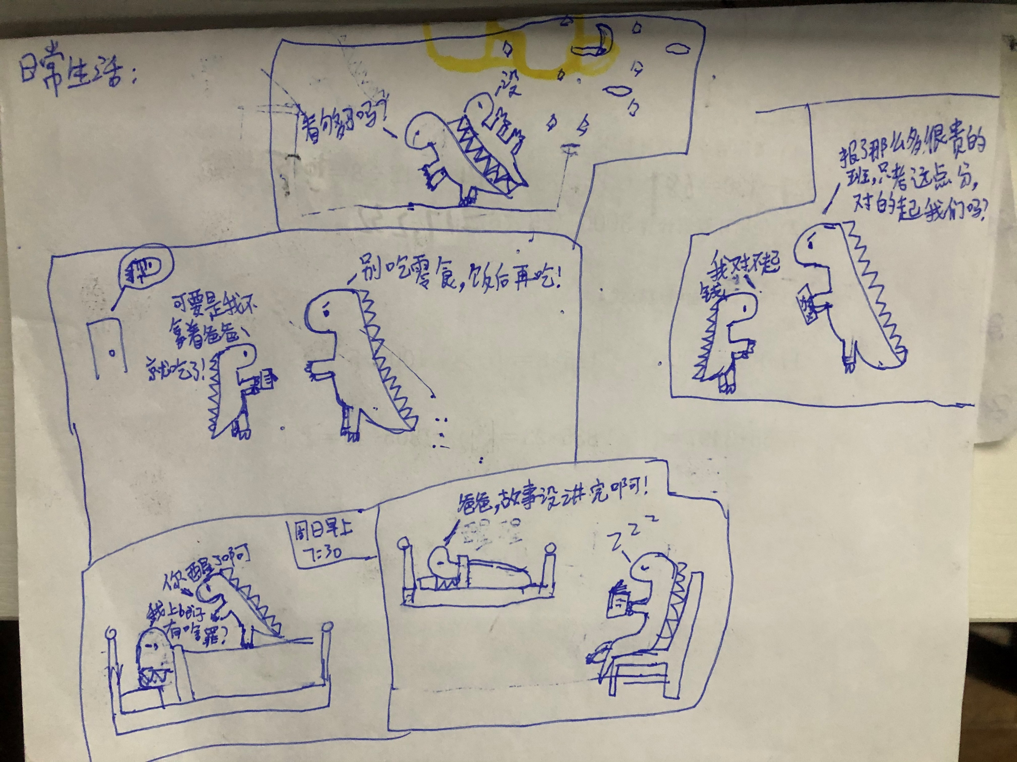
What AI capable of and not capable of? AI能做到什么？做不到什么？
AI is NOT capable of
人工智能做不到什么
Drawing something like this in five minutes

Slide 19
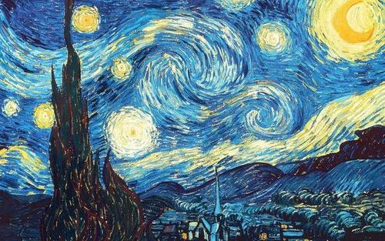
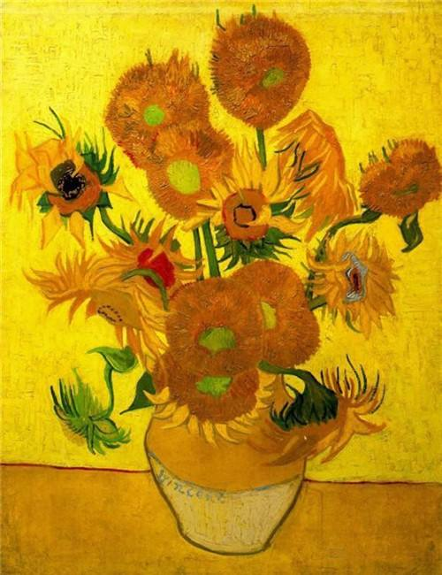
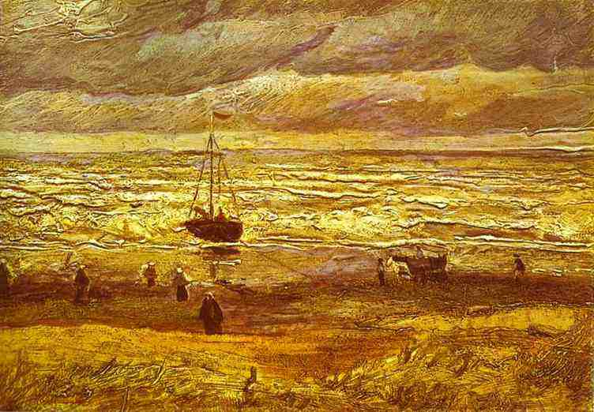
How could A.I. doing all these awesome things? 人工智能是如何做到这些炫酷的事的？
If a artificial neural network is big enough, it can approximate any function!!!
如果一个人工神经网络足够的大，那就能近似任意一个函数
Even though the function is beyond the capability of human recognition.
尽管某些函数超出当前人类的认知能力水平
Seed: 1010111001
Y=f(x)
Seed: 111000111
Seed: 100010010

Slide 20
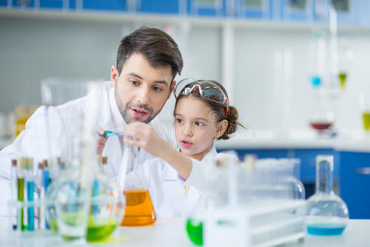


How could A.I. doing all these awesome things? 人工智能是如何做到这些炫酷的事的？
Before Neural Network was invented, humans have to define a mathematic model of the real world task by hand. In fact, most of the mathematic model is just a function.
神经网络被发明之前，真实世界任务的数学模型需要由人来手工建立。事实上，大多数情况下数学模型是一个函数。
But the parameters of model is still unknow, just after the function was created
但是，模型的参数在刚开始是未知的
And then we use the computers to figure it out
人们用计算机去算出来这些未知的参数
Finally, we can use the model to do some tasks.
最后呢，我们就能用这个做好的模型完成某个特定的任务。
Modelling period:
Humans design the function, like
y=a*x1 +b*x2 + c
y is function output
x1 and x2 are function input
a, b, and c are parameters
Training period:
Using known data to calculate parameters
Inferencing period:
Using the trained function to do
given task.

Slide 21
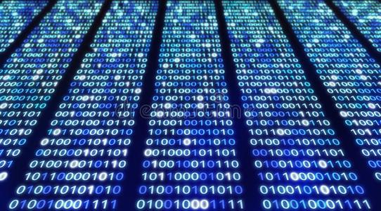
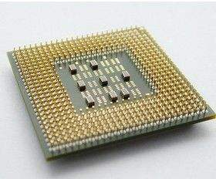


How could A.I. doing all these awesome things? 人工智能是如何做到这些炫酷的事的？
How a program that NOT followed Machine Learning principle working
一个不是基于机器学习原则的软件是如何工作的
A = 1
B = 2
Data 数据
C = 3
C = A + B
Result 结果
Model 模型
Inspired by Microsoft Ignite The Tour Slide which was illustrated by David.m.smith@Microsoft.com

Slide 22
How could A.I. doing all these awesome things? 人工智能是如何做到这些炫酷的事的？
How a program that followed Machine Learning principle working
一个基于机器学习原则的软件是如何工作的
A = 1
B = 2
Training Data 训练数据
C = 3
Training Result 训练结果
A = 10876
B = 74326
C = A + B
C = 85202
Data 数据
Model 模型
Result 结果
Inspired by Microsoft Ignite The Tour Slide which was illustrated by David.m.smith@Microsoft.com

Slide 23
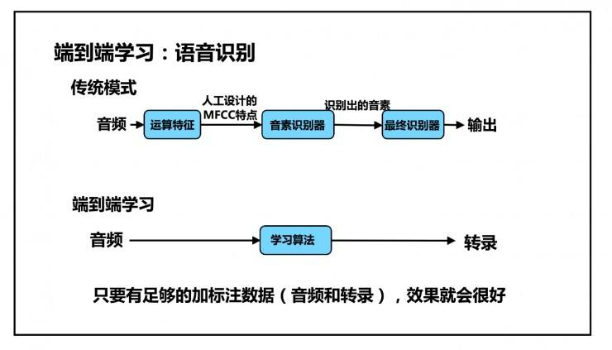
How could A.I. doing all these awesome things? 人工智能是如何做到这些炫酷的事的？
After neural network was invented, humans could use a deep neural network to approximate any function.
神经网络被发明之后，人类可以用神经网络来近似任意函数模型
Hence, scientists do not have to define a precise model by their own.
因此科学家无需再自己手工定义一个精准模型
According to the given data, computers could figure the function and the parameters out.
只需要让计算机自己根据训练数据去算出一个神经网络来最大化近似所需的函数模型

Slide 24
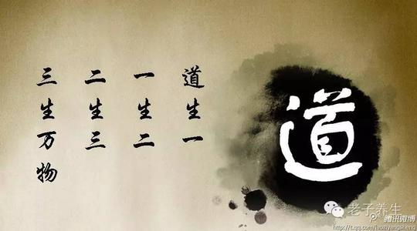
How could A.I. doing all these awesome things? 人工智能是如何做到这些炫酷的事的？
Fundamental: Data storing, searching, and calculating
计算机的基础：数据存储、检索和计算
Classification: i.e. classify cats pictures and dogs pictures
分类算法，例如识别图片中哪些是猫哪些是狗
Clustering: i.e. automatically aggregate similar person in groups among all of your classmate by the P.E. score
聚类算法，例如根据体育分数对你同学进行自动的小组划分
Regression: i.e. learning regulations from historical exam score, and use the learned regulation to predict a approximate feature exam score.
回归算法，例如根据以前的考试分数总结某个学生的分数规律，给出未来可能的考试分数
Some awesome task based on above, like draw a picture, sing a song, and so on
像A.I.画画、唱歌、写毛笔字、打游戏等看起来非常炫酷的任务，其实基本都是基于以上这些最简单最基础的功能组合并发展出来的
The effective combination of plenty of simple things may be a extraordinary thing.
非常简单的事物有效组合起来能成为非常腻害的玩意儿

Slide 25
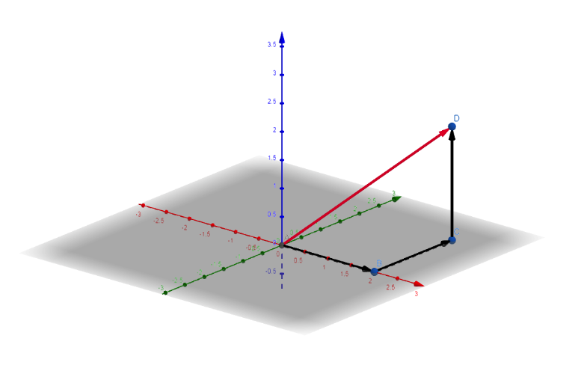
How could A.I. doing all these awesome things? 人工智能是如何做到这些炫酷的事的？
Computers using data to represent all the world.
计算机用数据来表示所有信息
For instance, the students and the exam score will been represented in a data table format.
例如，学生成绩表在计算机中实际是一串一串的数字
姓名 班级 考试日期 语文分 数学分 英语分
张三 三(9) 2019-10-10 91 92 93
李四 三(9) 2019-10-10 93 92 99
7012 3396 309 20191010 91 92 93
8763 0072 309 20191010 93 92 99
Put one line of data into the coordinate system, the data will represented as a vector
将任意一行数据放在相应维度的笛卡尔坐标系中，这行数据就表现为向量形式

Slide 26
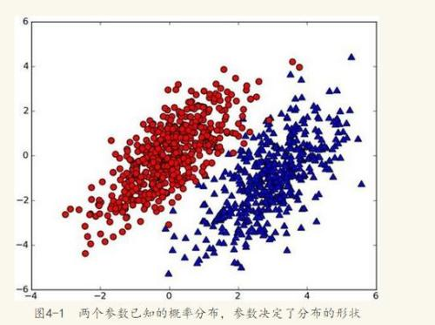
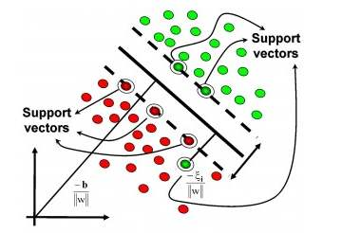
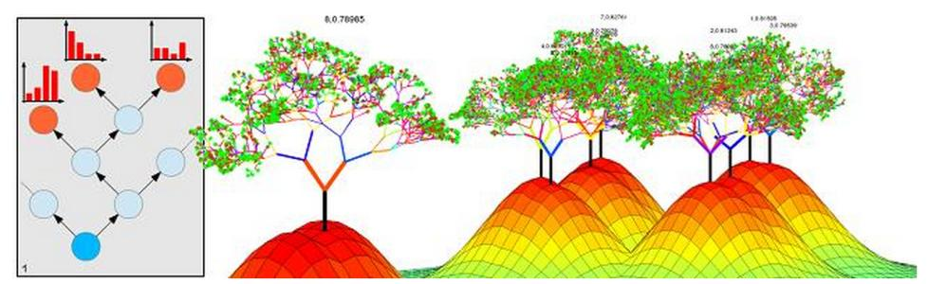
What is classification? 什么是分类算法
Trained with labeled data
用已经分好类的数据训练分类算法模型
Find a split line among different classes
训练成果是算法模型自己找到一条不同分类间的分割线（或高维分割面）
Use the split line to judge which class the unlabeled data belongs to
然后，算法就可以根据这条分割线对未分类的数据进行分类
Typical algorithm
Binary classification
SVM (stands for support vector machine)
Decision tree
Random forest
Typical binary classification
SVM
Decision tree and random forest

Slide 27
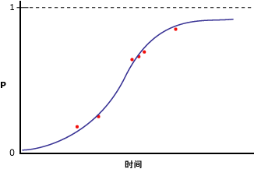
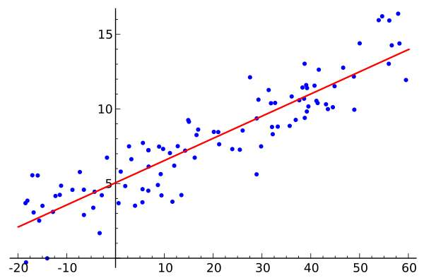
What is regression? 什么是回归算法
According to the given sparse data, find the regular pattern, represent the pattern with a math function
根据给定的零散数据，估计出这些数据的规律，并用某个函数定义这个规律
Using the found function to predict other data.
用找到的函数来预测其他数据

Slide 28
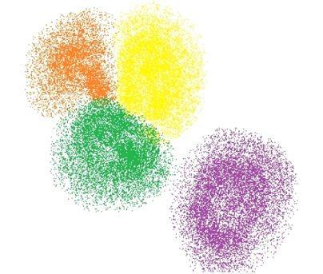
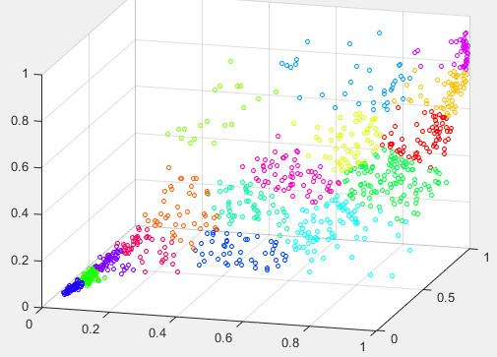
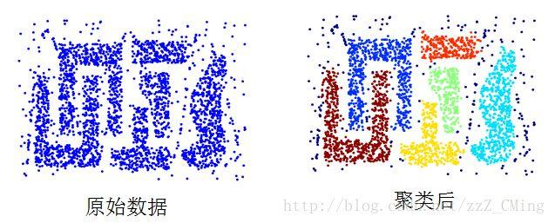
What is clustering? 什么是聚类算法
According to the given relationship such as distance, algorithm split the data into several groups
根据给定的衡量关系，如点距，算法将数据分割成若干个分类
Clustering may discover some unexpected regular patterns.
聚类算法可能发现人们意料之外的一些规律
二维空间聚类
三维空间聚类

Slide 29
Related mathematic concepts 相关的数学概念简介
Probability 概率
Linear algebra 线性代数
Calculus 微积分
Before we move forward and going deeper, there are three fundamental concepts you should know.
在我们继续深入理解本质原理之前，这些基本概念需要先有个大概的了解。

Slide 30
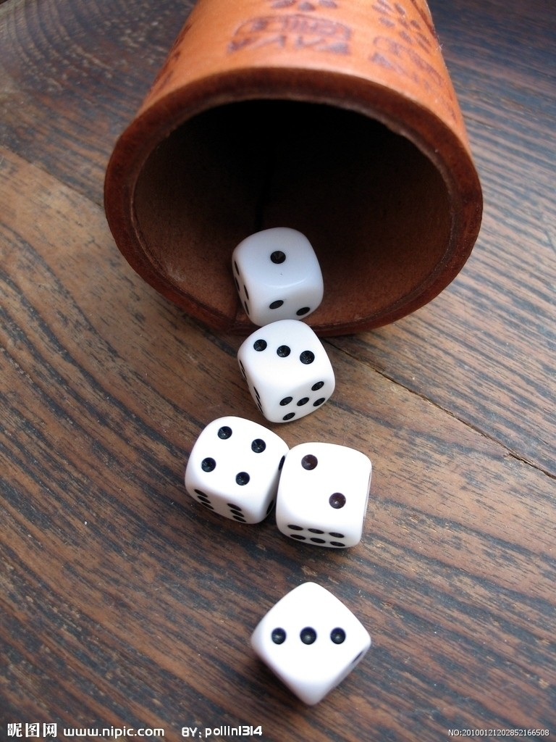

Fundamental probability concepts （1） 概率论基础概念—独立事件
Probability and statistics become the foundation of SOTA machine learning
概率和统计成为当前先进机器学习技术的理论基础
For a finger-bite shark, there are 11 tooth, push one of them will make the shark bite your finger. Therefore, the bite probability of each tooth is 1/11, likely 9%.
以一个咬手鲨鱼为例，总共有11颗牙齿，其中一颗被按下时鲨鱼会咬手指头。因此，每颗牙齿被咬手的概率都等于1/11，大约为9%。
For a dice, the probability of each number is 1/6. Because dice have six side, and each side got the equal chance.

Slide 31
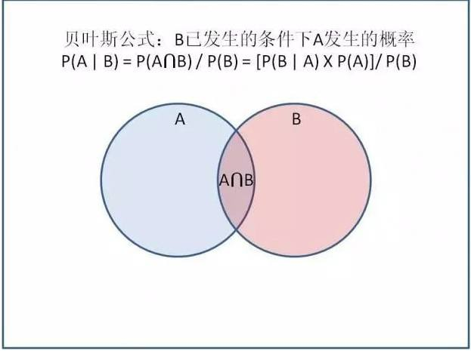
Fundamental probability concepts （2） 概率论基础概念—条件概率与贝叶斯公式
Bayes rule is a formula that can calculate the reverse probability.
贝叶斯公式是用来反推条件概率的
That is, given probability of event A B occurs and probability of event A occurs when event B was occurred, we use Bayes Rule to calculate probability of event B occurs when event A was occurred.
当知道逛商场的只有小姑娘和小伙子；小姑娘和小伙子总人数相等；小姑娘八成爱逛商场；小伙子只有一成爱逛商场。求逛商场的任意一个人是小姑娘的可能性百分比。
ADVANCED: Why there are so many boys in shopping mall walking with a boring face? It is not fit to the probabilities.
进阶问题：为什么逛商场的人里，脸上写满无奈无聊的小伙子人数远超总人数的10%？

Slide 32
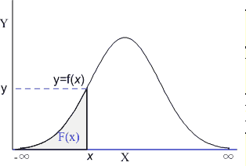
Fundamental probability concepts （3） 概率论基础概念—概率密度函数
Probability density function
概率密度函数
For short, probability density function is a function like p=P(a), which input is the event value , output is the probability of the event.
Probability density curve
概率密度函数曲线
Plot every event value and the probability of the event in a Cartesian coordinate system, all the dot liked as a curve, that is the density curve.
将每个可能的取值和其对应的概率值标注在笛卡尔坐标系中，所有点连起来是一个曲线，这就是概率密度函数曲线
Y axis is the probability of each specific score you may get in the next exam
X axis is the math exam score, from 0 to 100

Slide 33
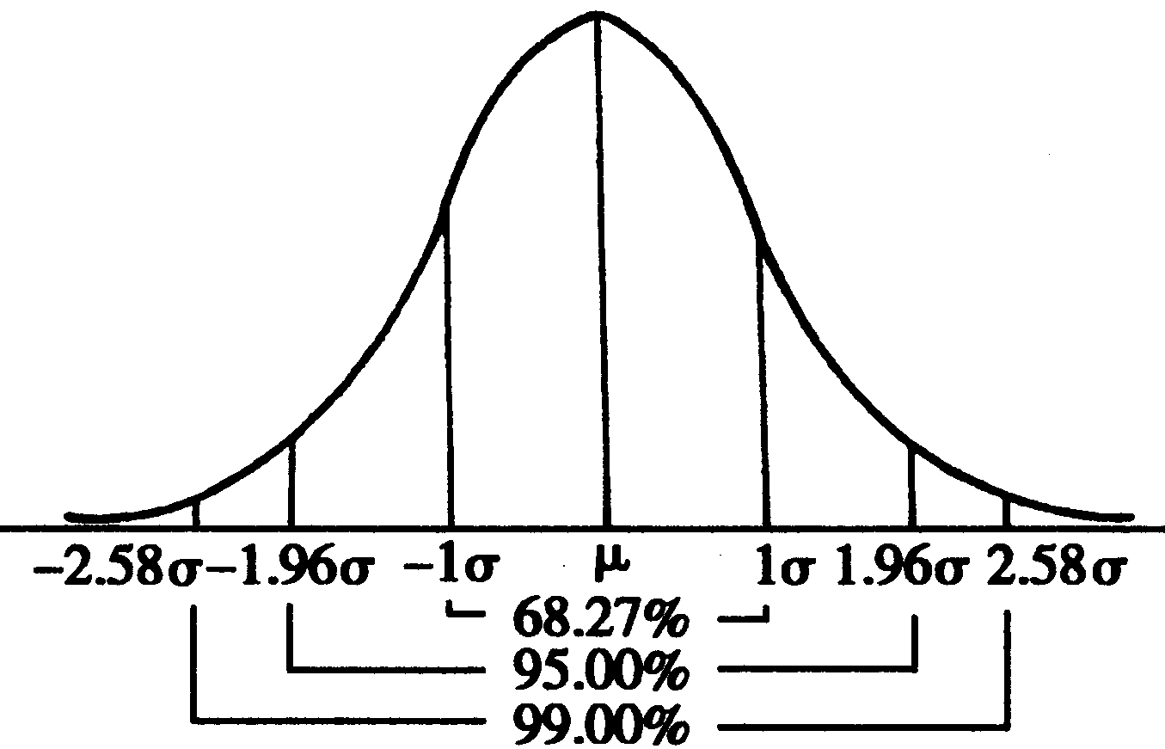
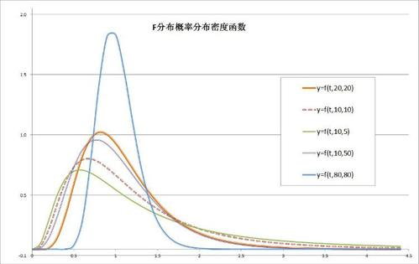
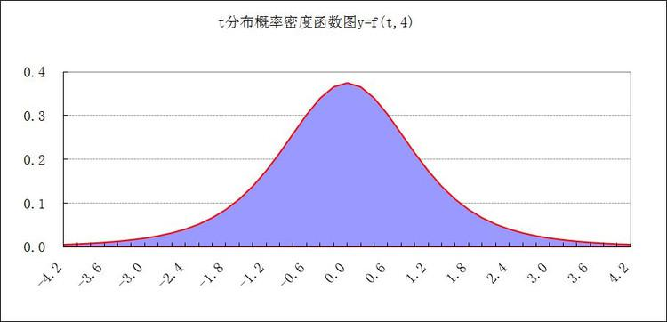
Fundamental probability concepts （4） 概率论基础概念—常见典型分布
Normal distribution A.K.A Gaussian distribution is a very important tool
正态分布（又称高斯分布)是一个非常重要的统计概率工具
There are t distribution (A.K.A student distribution), F distribution other than Gaussian distribution.
除了常见的正态分布外，还有t分布、 F分布等不同的概率分布

Slide 34
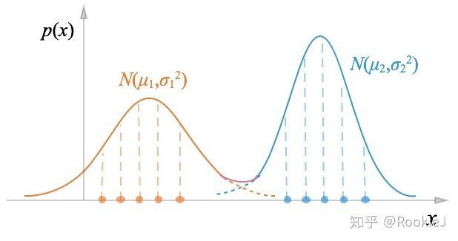
Fundamental probability concepts （5） 概率论基础概念—高斯混合模型
NOT every distribution subject to the simple distribution we defined.
不是所有的概率分布都服从人类定义的简单分布
Gaussian mixture model is such a model that combine several Gaussian model to approximate any distribution.
高斯混合模型是用多个高斯分布的叠加来近似任意一个概率分布的
Gaussian mixture model
混合高斯模型

Slide 35

Fundamental probability concepts （6） 概率论基础概念—统计推断
Father wants to know your math level comparing to all your classmates, but he has only your math exam score
老爸想知道你在同班同学里的相对数学水平，但是老爸只知道你自己的数学考试分数
Get the math score of all your classmates is too much trouble
拿到全部你同班同学的数学考试分数太麻烦
Get your class neighbor’s score is quiet easy. Let’s do this. That is called sampling
拿到你附近同学的分数很容易，这个叫抽样
We calculate the mean score and the standard deviation
我们曾经用平均值（期望）公式和标准差公式对你附近同学的分数进行过计算
We use your class neighbor’s scores to approximate all your classmate’s math capability.
用你附近同学的分数来代替全体同班同学进行分析，
Finally, father knows your math level by comparing your score to your classmates’
最后呢，老爸就大概知道相对于你同班同学来说，你的数学水平处于什么水准
If you are bothered with learning statistics in the future, just remember, we’ve played this game several times, this will helps you to got a very easy and clear understanding of statistics and sampling.
将来学习抽样、统计等时，你大概回忆一下我们玩儿过数次的这个游戏，就会对那些粗看起来复杂的公式和枯燥的讲解有一个非常非常清晰易懂的深刻理解。

Slide 36

Fundamental linear algebra concepts （1） 线性代数基础概念—起源、用途、矩阵与向量的基本概念
In the beginning, linear algebra was born to solve the system of equations quickly.
起初，线性代数是为了快速求解方程组问题而诞生的
Mathematicians use matrix and vector to simplify the representation of equations.
数学家们用矩阵和向量来简化方程组的表达形式
Lots of math tools was created for quickly matrix calculation.
为了快速的矩阵计算，非常多的方法和工具被创造出来了
Smart peoples use linear algebra approaches to accelerate the solving of other problems which can been represented in matrix and vector form.
后来聪明的人们用这些线性代数方法来加速其他能用矩阵向量形式表达问题的求解
In matrix, one line or one column was called vector
其中一行或一列被称为向量

Slide 37
Fundamental linear algebra concepts （2） 线性代数基础概念—向量数字与几何意义
The vector concept in geometry
几何图形中的向量概念
The original vector is consist of the numbers of its coordinates
从坐标系原点出发的任意向量均可表达为其端点的坐标值数组
For example, (3,6,9) is a vector represented in a array formation.

Slide 38

Fundamental calculus concepts （1） 微积分基础概念—导数
函数在某一点上的导数等于该函数这一点的斜率
The derivative of the given function at specific point equals to the gradient of the curve at the point.

Slide 39


Fundamental calculus concepts （2） 微积分基础概念—偏导数
偏导数partial derivative
Partial derivative is the gradient of the curved surface in a specific given point and direction.
偏导数可以理解为曲面在某个点某个指定方向上的斜率。
For a intuition understanding, cut the surface with a knife. You may see a curve at the edge, the derivative of this edge curve is the partial derivative on this direction.
在多维空间中沿着不同的轴对曲面切割形成的曲线，该曲线的导数就是曲面对该轴的偏导数

Slide 40


Fundamental calculus concepts （3） 微积分基础概念—积分

Slide 41


How does A.I. drawing a picture by itself 人工智能如何自主画画的数学与计算机原理
For a fixed-size canvas and digitalized color representation, the combination of every possibility of color of each pixel is a complete probability space.
给定尺寸的画布和颜色的数字表示标准，所有点颜色的组合是一个全概率空间
But there are only very few of them could be called a picture.
但是其中仅有非常少的一部分可以成为画
The A.I. algorithm calculate the boundaries of the combination that could be called a picture, by learning a lot of human made picture.
算法通过对人类绘画的大量反复运算，大致计算出在所有点颜色组合中哪里大概率是人类看起来认为是画的边界
Choose a combination within the boundaries, that is a generated picture.
通过在这个边界内随机选取一点，来生成一个点颜色组合
Computers do not have any sense of beauty, it ‘draws’ a picture only by the calculation of probability.
本质：计算机并没有任何美感，纯粹是概率计算来给出画作

Slide 42


A.I. will boost the fundamental science, which is the corner stone of human civilization 人工智能将增强人类文明的基石：基础科学的发展
The findings of modern science is all based on the regular pattern of the nature, and described in a human readable formation.
现代科学的发现都是基于对自然世界的客观规律的不断发现探索，并将这些规律用人类可以理解并运用的形式描述出来
But human brain has it’s own limitations. We may not find some complex regular pattern, due to our biological limitations.
但是人类的大脑有其自身固有的限制，我们可能无法发现大自然中很多复杂的规律。

Slide 43


A.I. will boost the fundamental science, which is the corner stone of human civilization 人工智能将增强人类文明的基石：基础科学的发展
The A.I. was more capable of find complex pattern in nature.
而人工智能将更可能有效地找到大自然中的复杂规律
But A.I. still can not represent its findings in a human understandable formation now.
但是人工智能目前还无法把找到的规律用人类可以理解的形式表示出来。

Slide 44
What will A.I. changes the world? 人工智能将会改变世界哪些方面
It is an ass-kicking powerful technology and tool, it will changes everywhere in the world.
人工智能是一种超级“勥”的技术和工具，将会改变世界的每一个角落。
Some opponents of my opinion claim that the developing of A.I. will leads to massive poverty, even it will leads to the extinction of human race.
一些持反对意见的人声称：人工智能的发展将导致大规模贫困，甚至人类的种族灭亡
I still insist that the benefits overcomes the inconveniences.
人工智能带来的益处会超过其带来的不利之处
Firstly, a knife could not kills a man, a man kills a man.
首先，人工智能技术不会害人，是人害人。
Secondly, according to the word someone said ‘produce relation adapts the productivity’. The revolution of produce relation is the matter of government.
其次，经济学与社会学原理告诉我们，生产关系必须和生产力匹配，否则社会结构会发生颠覆性的革命。当人工智能提升生产力的同时一定会带来生产关系问题，但这个是政府所需要考虑解决的问题。
Last but not least, there are competitions among the countries in the world, according to the Game Theory, Nash equilibrium rule will force all these countries to accelerate their own investment on the A.I.
最后，在这个小小的地球村上有很多很多的国家， 这些国家之间是有竞争关系的，根据博弈论中纳什均衡原则，大国之间的竞争将驱动几乎每个大国加速在人工智能方向上的资源投入。

Slide 45


What is Game Theory? 博弈论与纳什均衡的基础概念

Slide 46

Using the Game Theory to predict gov’s decision 用博弈论来解释预测政府的决定
The Nash equilibrium rule will drive all the countries to enforce the investment on the A.I. R&D
根据纳什均衡原理，所有的国家均会试图增强本国在A.I.方面的投入，否则就会在全球竞争之中出于劣势，受到损失
Just like the A-Bomb, it is very dangerous but every countries was eager to have it, or they may lose the rights to call the shot.
就像核弹，即使是非常危险的武器，每个国家都想拥有这种武器，否则将失去在国际上某些事务的主导权。

Slide 47
Why people must embrace it? 为何各行业岗位的人们需要主动拥抱这个变化?
If you want to become someone listed below, there are some reasons of you must embrace A.I.
如果宝贝儿你将来希望成为以下几种人物之一，我把必须主动拥抱人工智能技术的原因列出来供你参考
A governor 政府公务员
An entrepreneur 企业家
A freelancer 自由职业者
An investor 投资人
A scientist 科学家
A professional manager 职业经理人
A worker 工人
A farmer 农民
A solider 军人
A teacher 教师
A doctor 医生

Slide 48
Why people must embrace it? 为何各行业岗位的人们需要主动拥抱这个变化?
The figure illustrates the produce function of single industry or single organization
右图展示了单一产业或组织的生产函数
Management and technology is the parameter of produce efficiency
管理和技术决定了生产效率
Capital and talent is factor of input, they have strong linear relationship with amount of output
资本和人才是要素投入，决定了产出规模
A.I. is such a technology that may applies to every industry
人工智能是可以应用到每个产业或组织的技术
A.I. may remarkably improve the produce efficiency of some tasks in every industries.
人工智能将会显著提升某些环节的生产效率
Some efficiency improvements will cause the change of produce structure and work flow.
某些显著的效率提升将会导致生产结构和工作流程的改变
Therefore, A.I. will bring significant changes to every industries.
因此，人工智能会给每个产业带来显著的改变
Management
管理
Technology
技术
Capital
资本
Apply
应用
Industry or organization
产业、企业
Product, service
产品、服务
Input
投入
Output
产出
Talent
人才
Notes:
Output = f (input) =>> output =(a x MgmtLevel + b x TechnologyLevel)( c x Capital)(d x TalentIndicator)
Is this model right? Or maybe there are some DNN can approximate this produce function?

Slide 49
Why people must embrace it? 为何各行业岗位的人们需要主动拥抱这个变化?
Actually, there are so many industries in the real world, and they cooperate like a very complex network
事实上，在现实世界中有非常非常多的产业组织，这些产业组织之间的合作像一个及其复杂的网络
Each organization pay attention to their own produce function
每个组织关注其自己的生产函数
Government pays attention to the resource allocation for the total produce efficiency
政府关注全社会的资源合理分配来提高整体生产效率
Decades ago, almost every organization pay attention to their environment according to the BOSTON five force competition model.
数十年前开始，几乎每个组织都关注自己所在环境,根据产业竞争的波士顿五力模型依然可以分析计算
Nowadays, the industry competition become to the whole industry chain level competition mode or the ecosystem competition.
现在有些组织已经开始以全产业链级别的竞争或者生态系统级别的竞争
That means, if there are anyone of your industry chain applies the advanced technology like A.I. , it will causes a influence to yourself, even you do NOT use any A.I. technologies.
这就是说，即使你将来所在的产业没有任何人引入人工智能等先进技术，但只要你所在的产业链中有人引入了人工智能等颠覆性的先进技术，也将对你所在的产业和组织带来相对显著的影响。
Organization
产业组织
Organization
产业组织
Organization
产业组织
Organization
产业组织
Organization
产业组织
Organization
产业组织
Consumer
消费者
Organization
产业组织
Organization
产业组织
Organization
产业组织
Organization
产业组织
Notes:
Is there any methodology to do the simulation of industry produce network? If NO, is there any algorithm to approximate the produce network?

Slide 50
Why people must embrace it? 为何各行业岗位的人们需要主动拥抱这个变化?
For instance 举例说明
As a governor, you’d better to got a sense of the effect of the applied A.I., which industry will change? When will it changes? How it changes? Which resource allocation plan is the better plan?
作为一个政府公务员，你得对人工智能的应用所带来的影响有正确的感知和认识。哪些产业会改变?什么时候会改变？如何改变？哪个资源配置方案是更好的？
As a scientist, you’d better to know the A.I. may helps you to discover more regular pattern of the unknow territories. Is there any algorithm may contribute to the problem solve of your interest?
作为一个科学家，你最好知道人工智能可能会帮助你发现人类未知领域中的客观规律，最好知道是否有任何算法能对你所感兴趣领域中的问题解决提供帮助
As a investor, you have to judge which business plan is more worthy to invest your limited funds. Which judgement based on the judge of the product is real advanced or just a technology fraud, which industries will benefits from the product, what is the tends of technology and market. And so on.
作为一个投资人，你必须判断哪个商业计划书是更值得投入你有限的资金的，这个判断将基于对哪个产品是真正的先进技术或只是一个技术欺诈，这个待投资的产品或业务对哪些产业能带来更高的价值，未来的技术和市场趋势如何等各个方面

Slide 51
Knowledge-set network and learning path 学习路径与知识集网络
A simple unprofessional classification method
一个简单且非专业的分类方法
Theory research：mathematics、medical science、psychology scientist plus computer scientist
理论研究：数学、医学、心理学与计算机科学的交叉学科
Technology R&D: implements the algorithm, choose and integrate the right algorithm to solve specific problem
技术研发：实现算法，为解决问题选择并整合合适的算法
Active using: Have awareness of A.I. may helps to solve problem, and looking for a technical solution actively.
主动使用：对人工智能可能帮助解决问题有认知，主动寻求技术解决方案
Passive using: Using any given device or given software, do NOT have any awareness of A.I. may helps them to do their own job more effectively.
被动使用：使用别人推荐的或给予的设备和软件，对人工智能有可能帮助自己更有效完成某些工作没有认知
There are some roles may across multiple layer, such as management, consultant
某些分工角色会涉及多个分层，例如管理、咨询等
Technology R&D
技术研发
Active using
主动使用
Passive using
被动使用
Theory research
理论研究

Slide 52
Some ridiculous examples of terminology abuse and negative results 一些荒诞的专业术语滥用的例子和负面影响
Bias 偏见
In fact, I think bias is a parameter of A.I. algorithms. For instance, in equation Y=aX + b, the b is the bias parameter
实际上，我认为偏见这个词源于人工智能算法中的偏置量术语单词bias
Further more, some model was trained with data which not fit to the task, i.e a African face recognizer algorithm trained with White face images. This is one sort of bias.
还有，有些算法模型的训练数据与应用场景差异太大，例如用白人数据训练出来的模型应用于黑人人脸识别。这种因训练数据而导致的误差在使用方看来存在偏见。
Some people, who are not professional and do not willing to know the true concept of AI, thought AI have bias issues when then heard the bias word in some professional technology conference or something like that.
一些不想了解真正技术概念的非专业人员在专业的技术会议什么的场合听到bias这个词后并未认识到这是数学公式的参数，而认为人工智能有偏见的问题，例如记者、翻译和政府官员
It leads to the public misunderstandings and refuse of AI
这导致了公众对AI的误解和抗拒

Slide 53
Some ridiculous examples of terminology abuse and negative results 一些荒诞的专业术语滥用的例子和负面影响
Dimension 维度
In fact, dimension is the terminology of mathematics, physics and data sciences
实际上，维度是数学、物理和数据科学常用的专业术语
Some people who pretend to be someone usually said ‘ Inspect the problem from different dimension’, it’s a typical abuse of terminology. You’d rather say different aspect than different dimension. Because problem have nothing to do with dimensions.
一些装逼犯经常说“要从不同的维度看问题”，这就是技术术语的典型滥用。因为问题这个概念本身跟维度没有半毛钱关系，最好说从不同的（利益、情感）角度看问题。
It leads to more terminology abuse and confusion
这导致了更多的术语滥用和困惑

Slide 54
The exercise 本课练习
Is there some regular pattern for the finger-bait shark?
咬手鲨鱼游戏有什么规律可循吗？
Find it
找到这个规律
Prove it
证明之
Notes:
1, 培养科学实验的过程习惯与科学分析的思维框架
Cultivate the good behavior and thinking framework
2，考察点，是否有基于常识的大胆假设，是否有合适并精确的实验方案设计来验证这些假设
Key point of student capability, does she have a audacious assumption based on the common sense? Does she design a appropriate experiment plan to verify the assumptions?
3，方法，比如利用数学和计算机技术；比如拆解玩具，根据机械原理来分析规律；
Methodology, black box approach: using mathematics and computer, or white box approach : disassemble the toy, find the pattern by analyze the mechanism structure.
4，选用不同的方法，在某种程度上体现了孩子的思维模式；假如能打破思维惯性，直接拆解玩具分析；还能同时用人工智能方法做出答案，这样的孩子是大概率未来能有所建树的人才
The method she choose, may the representation of her thinking pattern. If a kid can break the thought inertia, not only use the math and computers to solve this problem, but also can disassemble the toy, there is a great probability that she will became an innovative contributor in the furfure.

Slide 55

Thank you!
谢谢！
willswu@outlook.com
All rights reserved by the author.

